Slide 1













ECOBUCKS
MAKING SUSTAINABILITY A CHILD’S PLAY

Slide 2
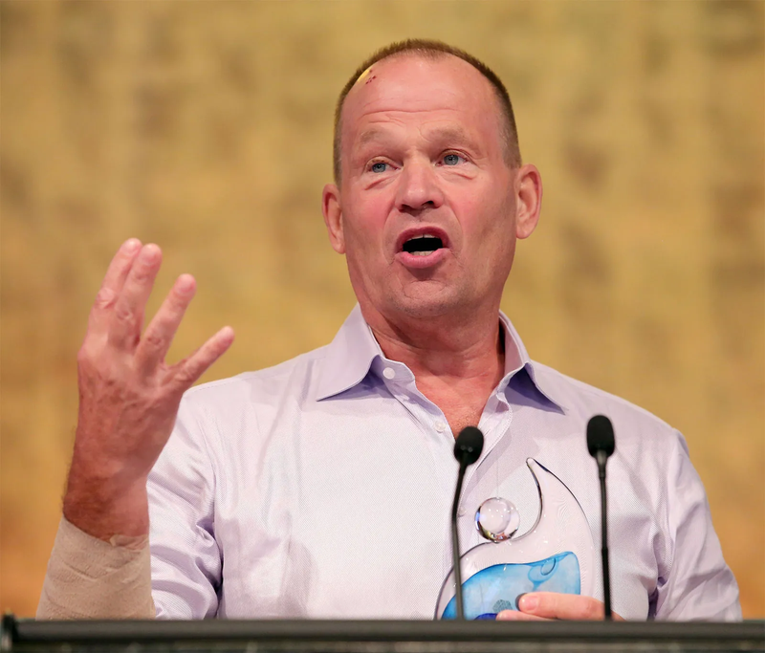
“The greatest threat to our planet is the belief that someone else will save it”
- Robert Swan (Explorer, Environmentalist

Slide 3

THE PROBLEM
Environmental awareness is crucial, yet many users struggle to find engaging, easy-to-follow ways to track and improve their sustainability practices. We aim to Provide an intuitive platform that encourages eco-friendly behavior through personalized challenges, rewards, and climate-focused education.

Slide 4




OUR APPROACH
“A dynamic app that promotes sustainability by offering daily eco-challenges, providing rewards like eco-certificates, and fostering environmental education through an interactive, user-friendly interface”
AKHILESH JC (Founder)
Daily Eco Tasks
Leaderboards
Gamification
Eco-Certificates

Slide 5





WHY ECOBUCKS IS SIMPLY BETTER ?
“We have architected EcoBucks to be an impactful movement with a practical perspective”
AYUSH ASHWIN (Co-Founder)

Slide 6



TECH STACK

Slide 7



BACKEND (SERVER & LOGIC)

Slide 8



FRONTEND (UI & UX)

Slide 9


DATABASE MANAGEMENT

Slide 10



FUTURE PROSPECTS
Eco Communities
Monthly Meetups
Eco-Brands Partnerships

Slide 11
THANK YOU FOR YOUR TIME

